Slide 1
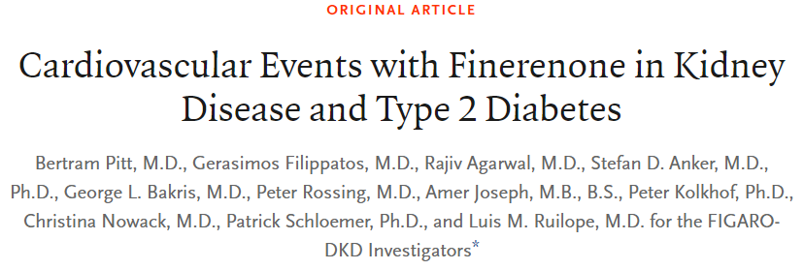
Presenter: Chia-Hsiang Kao (高家祥)
Supervisor: Fu-An Chen M.D. (陳甫安)

Slide 2
Take Home Message
Finerenone is a nonsteroidal, selective mineralocorticoid receptor antagonist.
Among patients with type 2 diabetes and stage 2 to 4 CKD with moderately elevated albuminuria or stage 1 or 2 CKD with severely elevated albuminuria, Finerenone therapy improved cardiovascular outcomes as compared with placebo.

Slide 3
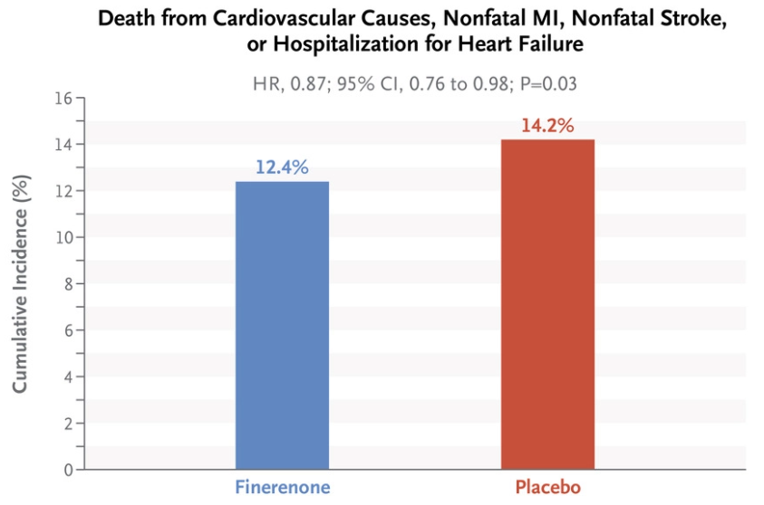
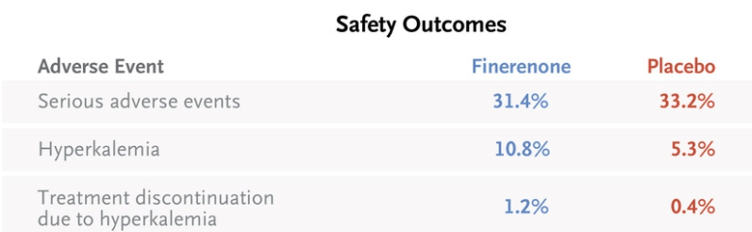
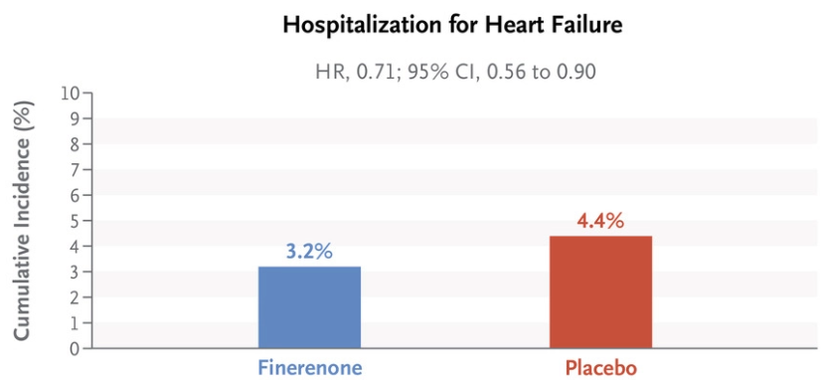
Take Home Message
Finerenone is a nonsteroidal, selective mineralocorticoid receptor antagonist.
Among patients with type 2 diabetes and stage 2 to 4 CKD with moderately elevated albuminuria or stage 1 or 2 CKD with severely elevated albuminuria, Finerenone therapy improved cardiovascular outcomes as compared with placebo.

Slide 4
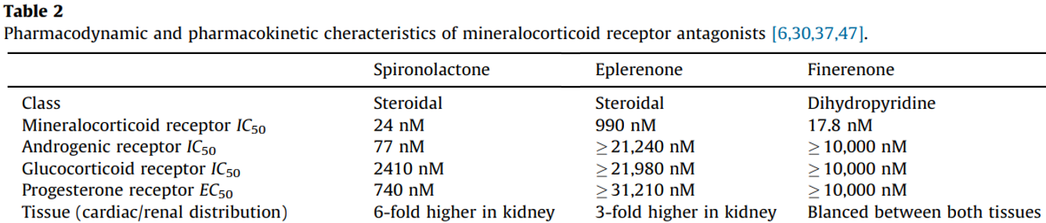
The Comparison of Spironolactone and Eplerenone
$$IC_{50}:\text{concentration} \text{required} \text{to} \text{inhibit}\text{ 50\% }\text{activation} \text{of} \text{the} \text{receptor}\text{.}$$
Ruilope, L. M., & Tamargo, J. (2017). Renin–angiotensin system blockade: Finerenone. Nephrologie & therapeutique, 13, S47-S53.

Slide 5
The Comparison of Spironolactone and Eplerenone
$$IC_{50}:\text{concentration} \text{required} \text{to} \text{inhibit}\text{ 50\% }\text{activation} \text{of} \text{the} \text{receptor}\text{.}$$
Ruilope, L. M., & Tamargo, J. (2017). Renin–angiotensin system blockade: Finerenone. Nephrologie & therapeutique, 13, S47-S53.

Slide 6
The Comparison of Spironolactone and Eplerenone
Spironolactone presents progestogenic and antiandrogenic activities.
- Produces sexual adverse effects, such as painful gynecomastia, painful enlargement of the breasts, loss of libido, impotence, and menstrual irregularities.
$$IC_{50}:\text{concentration} \text{required} \text{to} \text{inhibit}\text{ 50\% }\text{activation} \text{of} \text{the} \text{receptor}\text{.}$$
Ruilope, L. M., & Tamargo, J. (2017). Renin–angiotensin system blockade: Finerenone. Nephrologie & therapeutique, 13, S47-S53.

Slide 7
The Comparison of Spironolactone and Eplerenone
Spironolactone presents progestogenic and antiandrogenic activities.
- Produces sexual adverse effects, such as painful gynecomastia, painful enlargement of the breasts, loss of libido, impotence, and menstrual irregularities.
Eplerenone presents 20–40-fold lower affinity for the mineralocorticoid receptor.
- Less efficient in patients with hypertension or with primary hyperaldosteronism
$$IC_{50}:\text{concentration} \text{required} \text{to} \text{inhibit}\text{ 50\% }\text{activation} \text{of} \text{the} \text{receptor}\text{.}$$
Ruilope, L. M., & Tamargo, J. (2017). Renin–angiotensin system blockade: Finerenone. Nephrologie & therapeutique, 13, S47-S53.
Notes:
primary hyperaldosteronism

Slide 8
What is Finerenone?
Finerenone has
high affinity for the mineralocorticoid receptor as Spironolactone.
high selectivity for the mineralocorticoid receptor as Eplerenone. (non-steroidal).
Besides, Finerenone is a full antagonist in different cell types, while Spironolactone and Eplerenone have partial agonistic activity in some receptors, leading to early-onset HTN in men and gestational HTN in women.
Ruilope, L. M., & Tamargo, J. (2017). Renin–angiotensin system blockade: Finerenone. Nephrologie & therapeutique, 13, S47-S53.

Slide 9
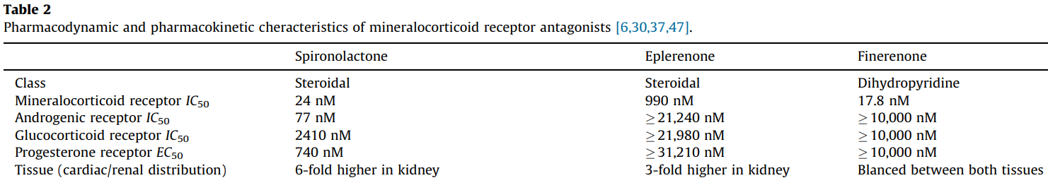
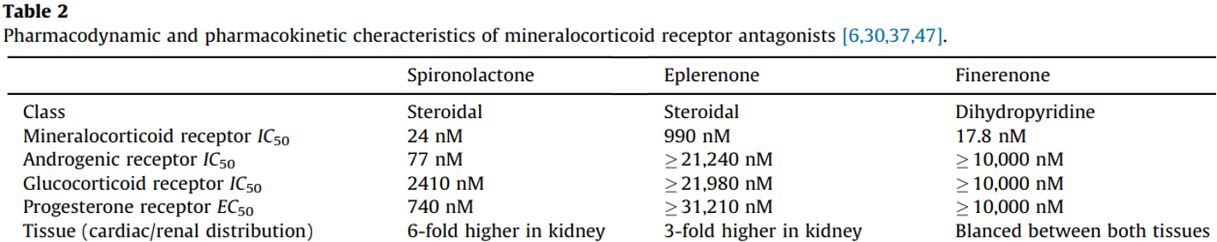

Slide 10
Research Question
Previous result
Finerenone improved kidney outcomes in patients with predominantly stage 3 or 4 CKD with severely elevated albuminuria and type 2 diabetes.
Research question
To understand if treatment with Finerenone would lead to lower risks of cardiovascular events and death from cardiovascular causes among patients with CKD with albuminuria and type 2 diabetes.

Slide 11
Methods – Trial Design
Research type
Phase 3. Double-blind, randomized, placebo-controlled, multicenter clinical trial.

Slide 12
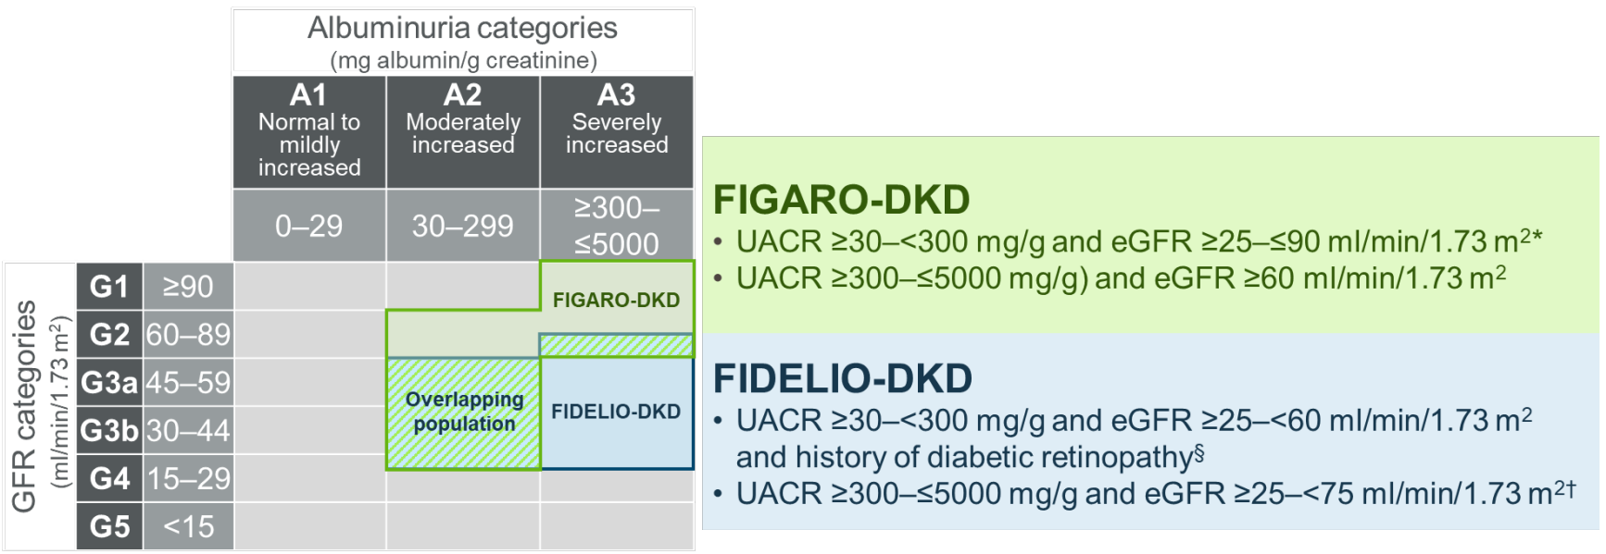
Methods – Trial Design
Patients
Adults with T2DM and CKD with two inclusion criteria.
✔
12

Slide 13
Methods – Trial Design
Patients
Adults with T2DM and CKD with two inclusion criteria.
Adults were treated with a renin– angiotensin system (RAS) inhibitor (ACEi or ARB) at the maximum dose on the manufacturer’s label that did not cause unacceptable side effects
13

Slide 14
Methods – Trial Design
Patients
Adults with T2DM and CKD with two inclusion criteria.
Adults were treated with a renin– angiotensin system (RAS) inhibitor (ACEi or ARB) at the maximum dose on the manufacturer’s label that did not cause unacceptable side effects
Exclusion of patients who had symptomatic heart failure with a reduced ejection fraction.
14

Slide 15
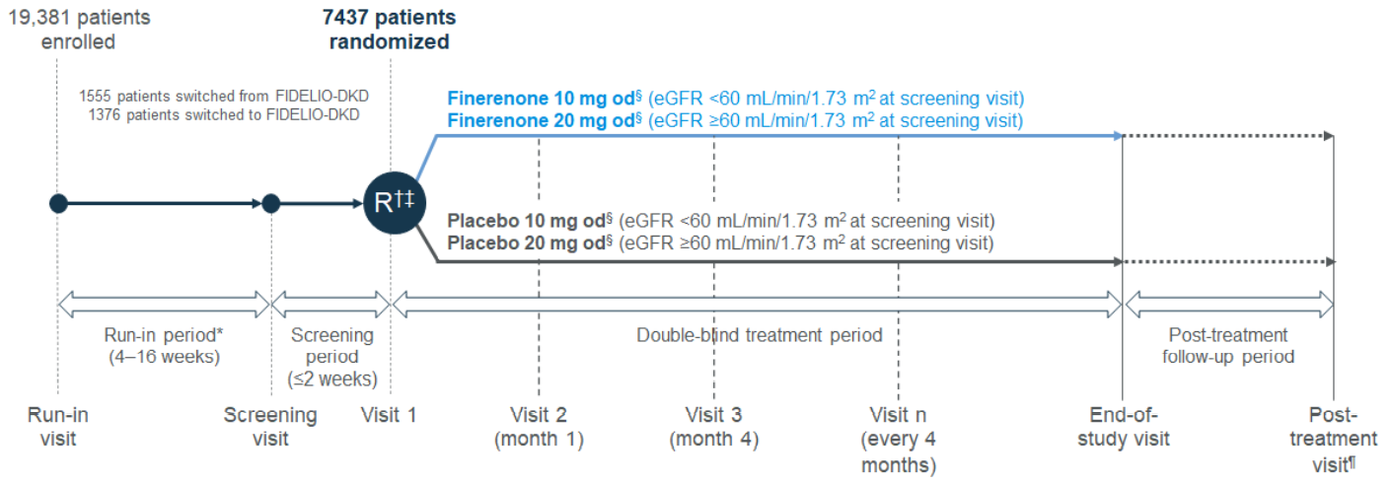
Methods – Trial Procedure
Maximal dose adjustment

Slide 16
Methods – Trial Procedure
Increase dosage (encouraged): From 10 to 20 mg once daily after 1 month, if serum potassium level was < 4.8 mEq.
Withdrawal: Finerenone or placebo was withheld if serum potassium level > 5.5 mEq and restarted when if it fell to 5.0 mEq or less.

Slide 17
Methods – Outcomes
Primary outcomes:
Death from cardiovascular causes
Nonfatal myocardial infarction
Nonfatal stroke
Hospitalization for heart failure
Secondary outcomes:
Kidney failure (eGFR<15).
A sustained decrease of at least 40% in the eGFR from baseline over a period of at least 4 weeks
Death from renal causes.

Slide 18
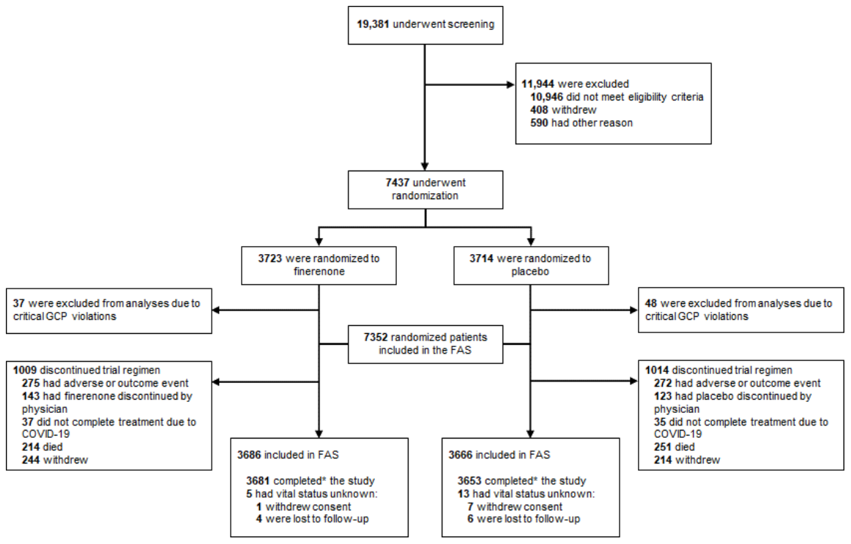
Results – Demographic and Clinical Characteristics
From 2015 to 2018, 19381 patients in 48 countries underwent screening, and 7437 patients underwent randomization.

Slide 19
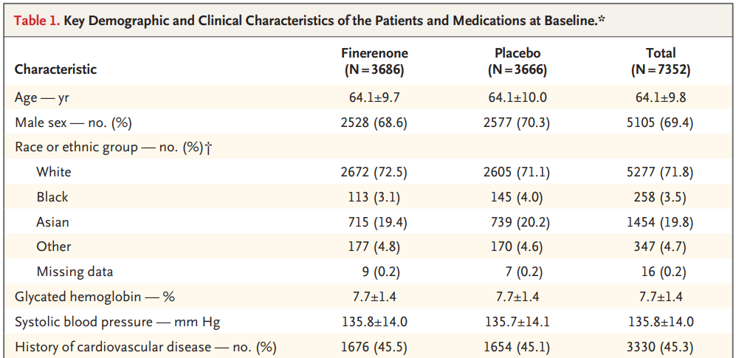
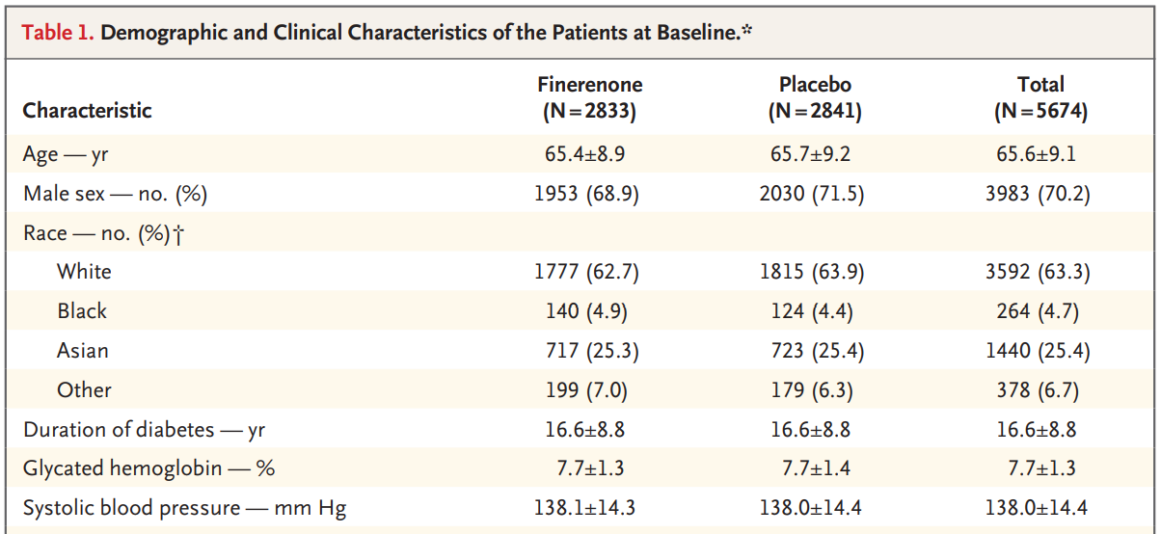
Results – Demographic and Clinical Characteristics

Slide 20
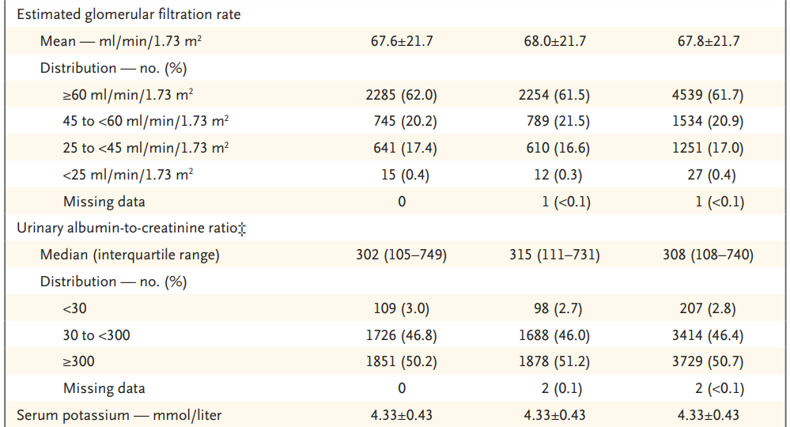

Slide 21
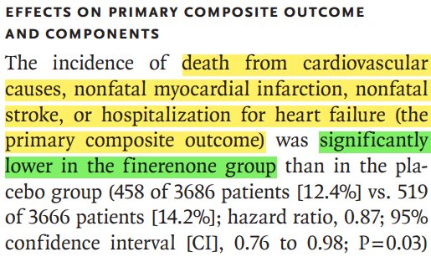
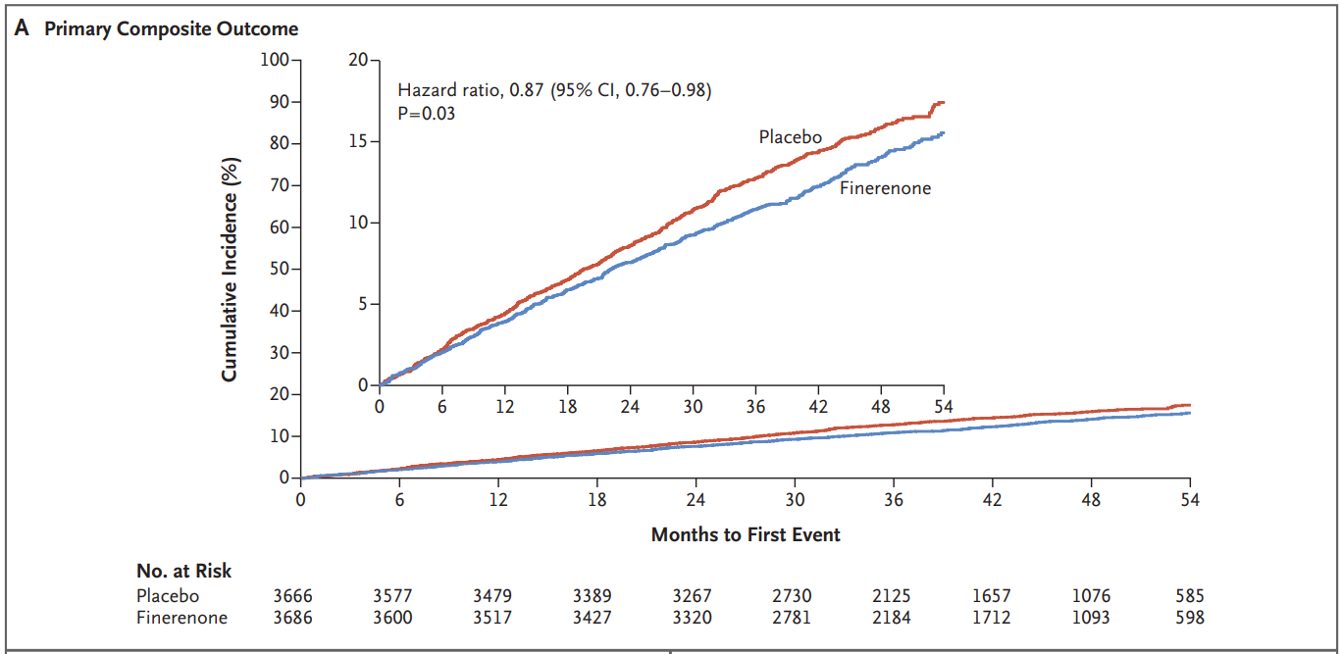
Results – Primary Outcome

Slide 22
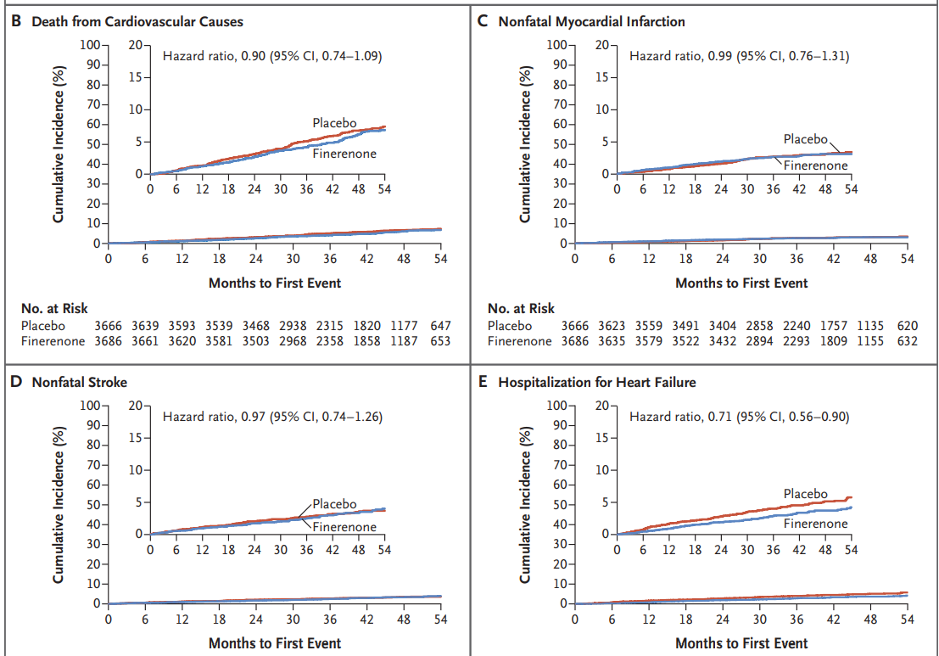
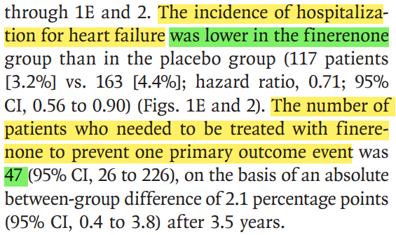
Results – Primary Outcome

Slide 23
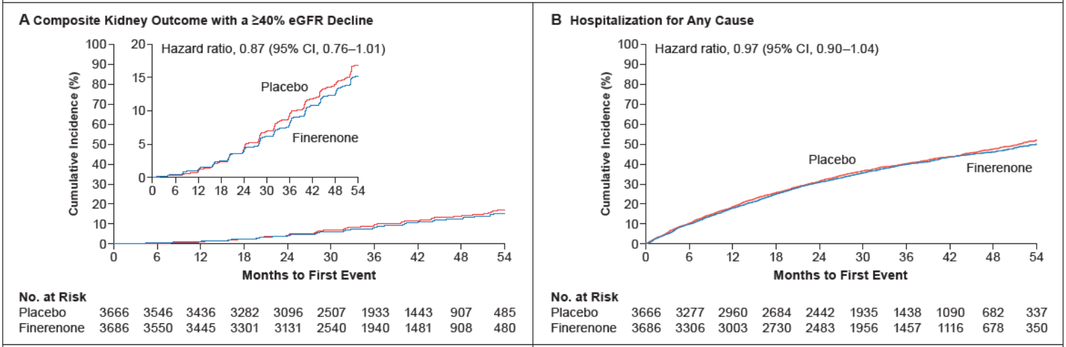
Results – Secondary Outcome

Slide 24
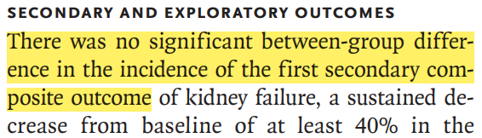
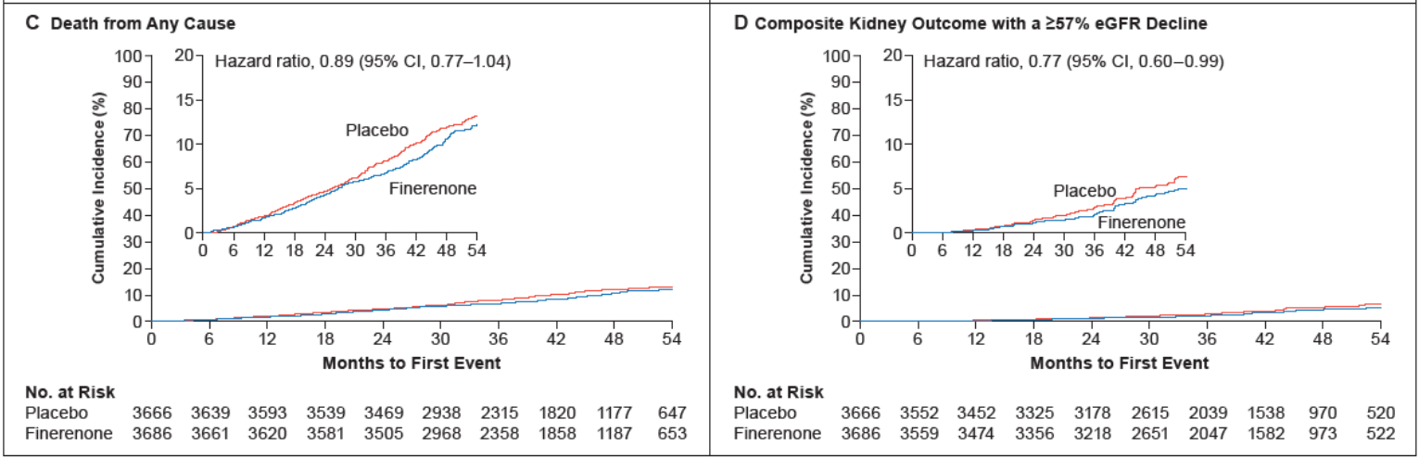
Results – Secondary Outcome

Slide 25
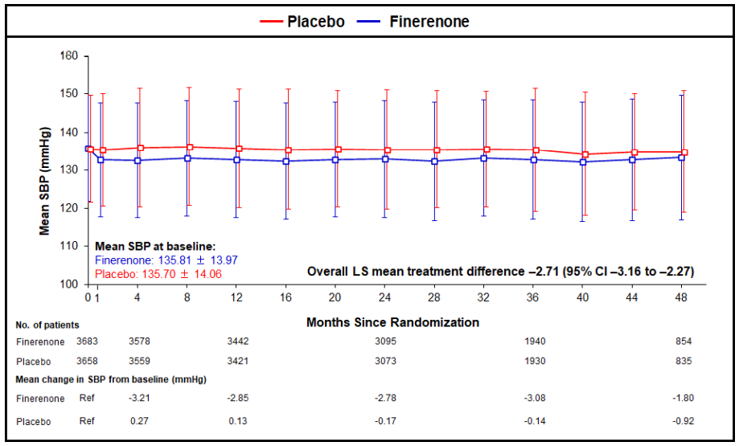
Results – Other Outcomes

Slide 26
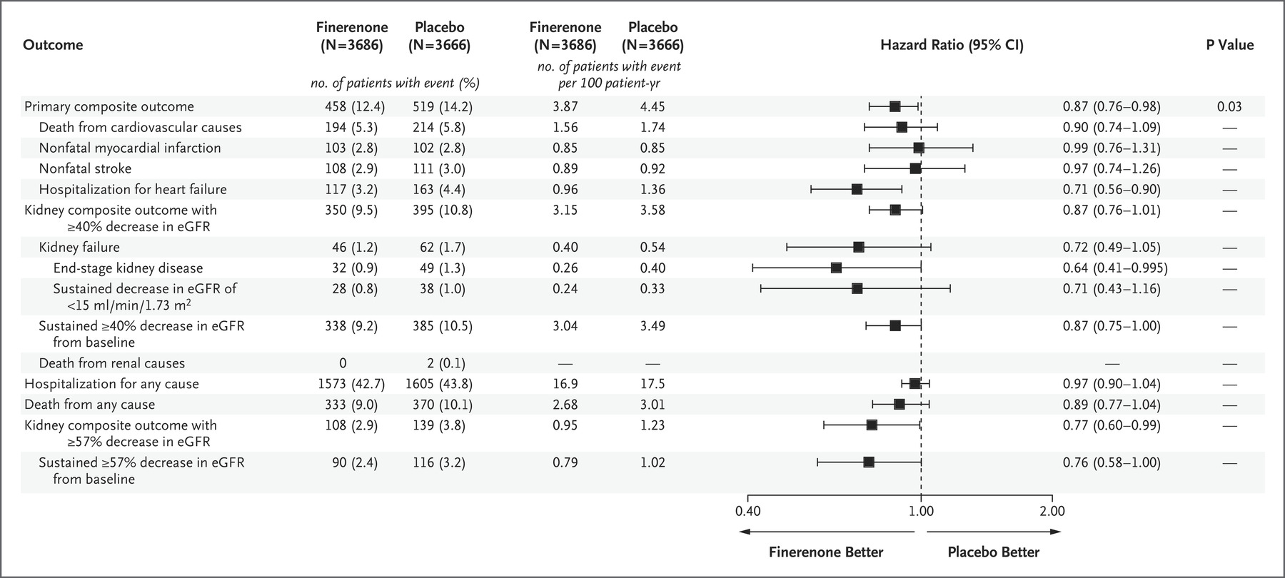
Results – Efficacy Outcomes

Slide 27
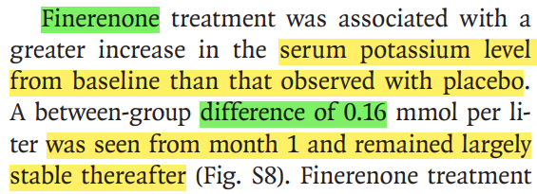
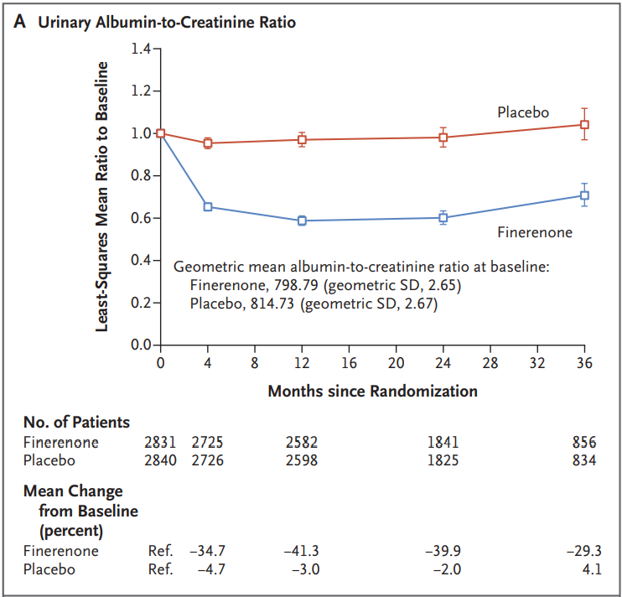
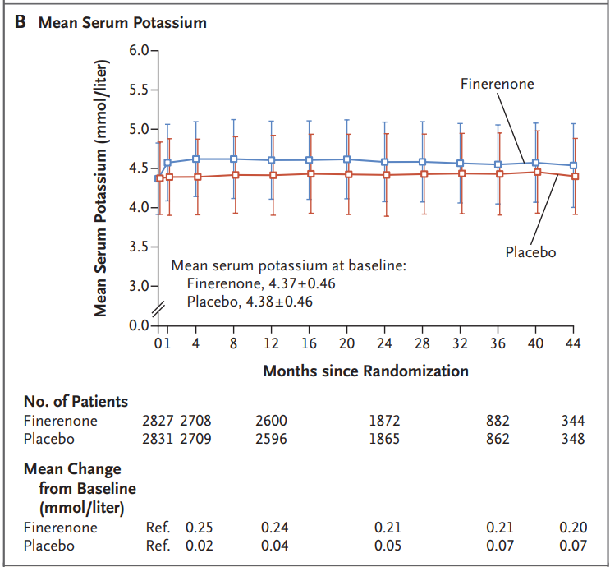
Results – Effects on Albuminuria and Serum Potassium
30.0%

Slide 28
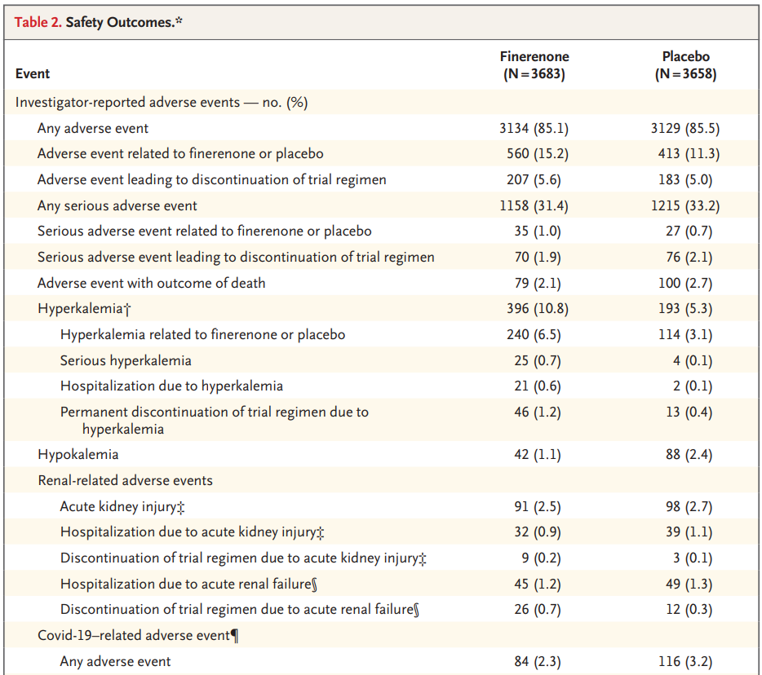
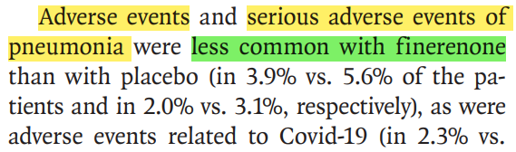
Results – Safety Outcomes.

Slide 29
Discussion - Early Stage and Late Stage Benefits
In this trial, the early reduction in albuminuria, early separation of the Kaplan–Meier curves for the key secondary outcome, and modest blood-pressure reduction suggest that some benefits of Finerenone may partly be mediated by natriuretic mechanisms.

Slide 30
Discussion - Early Stage and Late Stage Benefits
In this trial, the early reduction in albuminuria, early separation of the Kaplan–Meier curves for the key secondary outcome, and modest blood-pressure reduction suggest that some benefits of Finerenone may partly be mediated by natriuretic mechanisms.
Preclinical data showed that the kidney and cardiovascular benefits of Finerenone were associated with potent anti-inflammatory and anti-fibrotic effects through inhibition of overactivation of the mineralocorticoid receptor.
The delayed separation of the Kaplan–Meier curves for the primary outcome and persistent benefit over the trial duration provide evidence to support the hypothesis that Finerenone may slow CKD progression by influencing tissue remodeling.

Slide 31
Discussion - Limitations
Patients with non-albuminuric CKD are not included.
Only 4.7% of the participating patients identified themselves as Black.

Slide 32
Take Home Message
Finerenone is a nonsteroidal, selective mineralocorticoid receptor antagonist.
Among patients with type 2 diabetes and stage 2 to 4 CKD with moderately elevated albuminuria or stage 1 or 2 CKD with severely elevated albuminuria, Finerenone therapy improved cardiovascular outcomes as compared with placebo.

